Slide 1
Lab 1
How to download and Install VMware
Instructor Name:
Fahad Burhan Ahmad

Slide 2
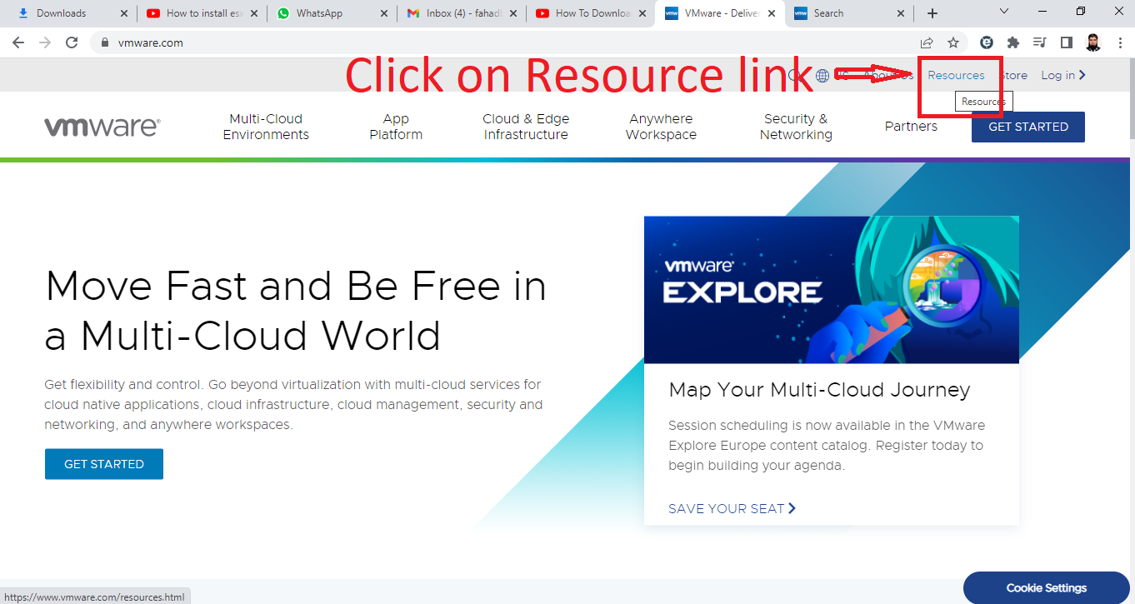
Open website: www.vmware.com

Slide 3
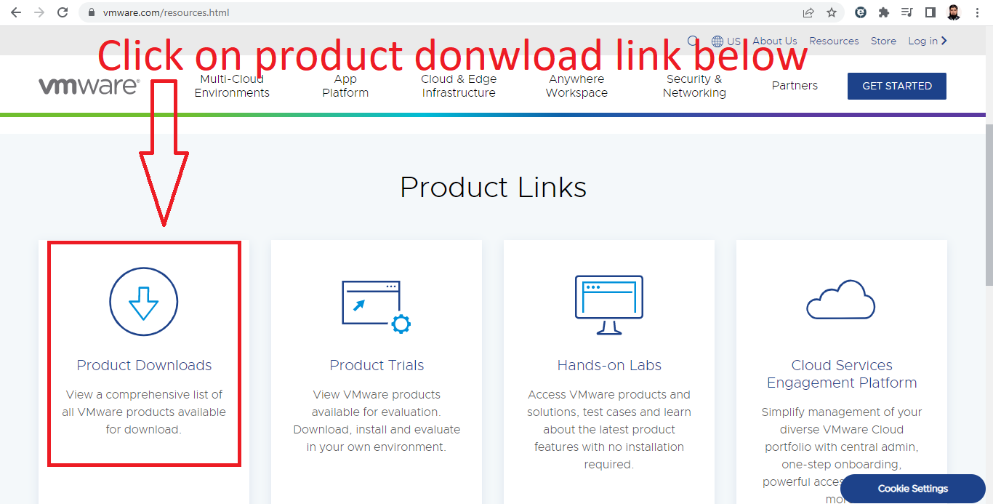
Drag down the page and find the product download

Slide 4
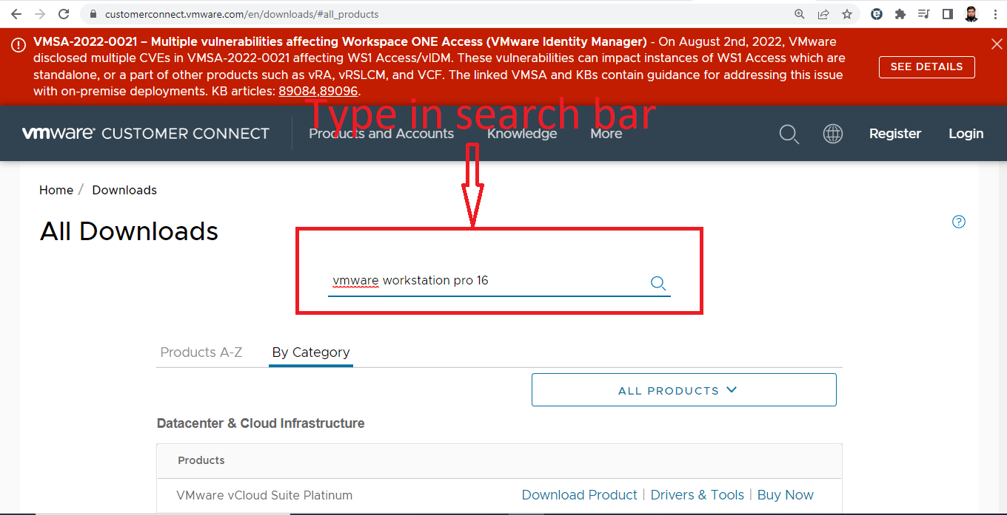
Find the search bar and type vmware workstation pro 16 for windows and press enter

Slide 5
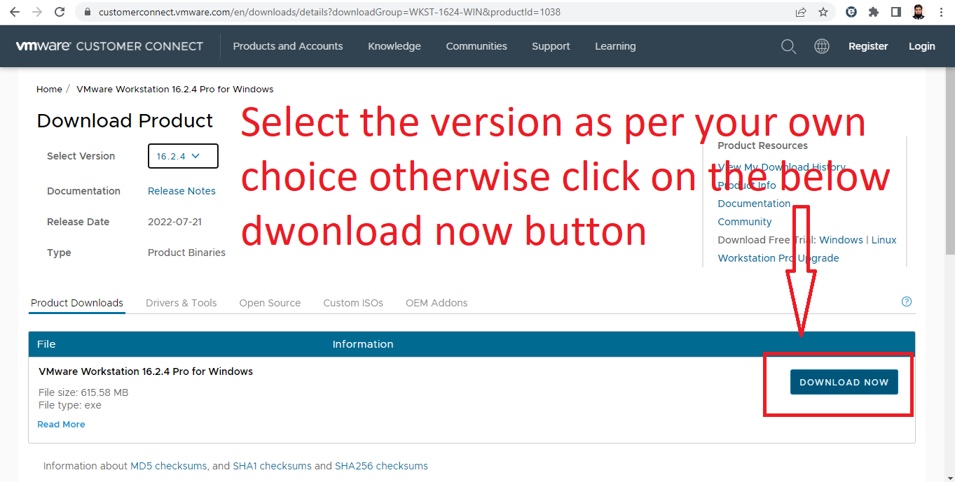
Click on download now button below

Slide 6
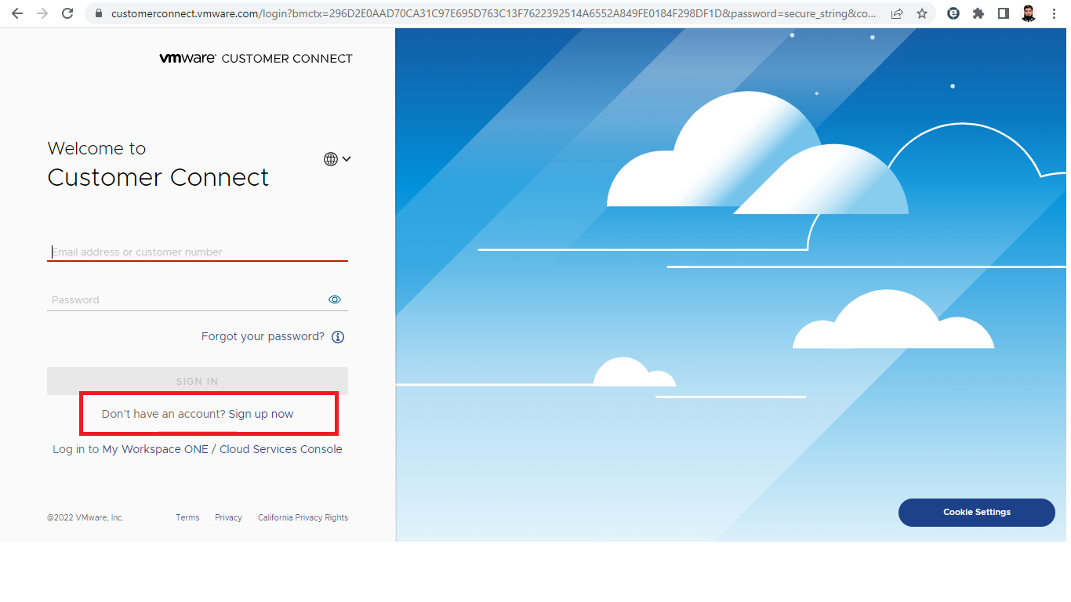
If you visit the website for first time now you can click on sign up now

Slide 7
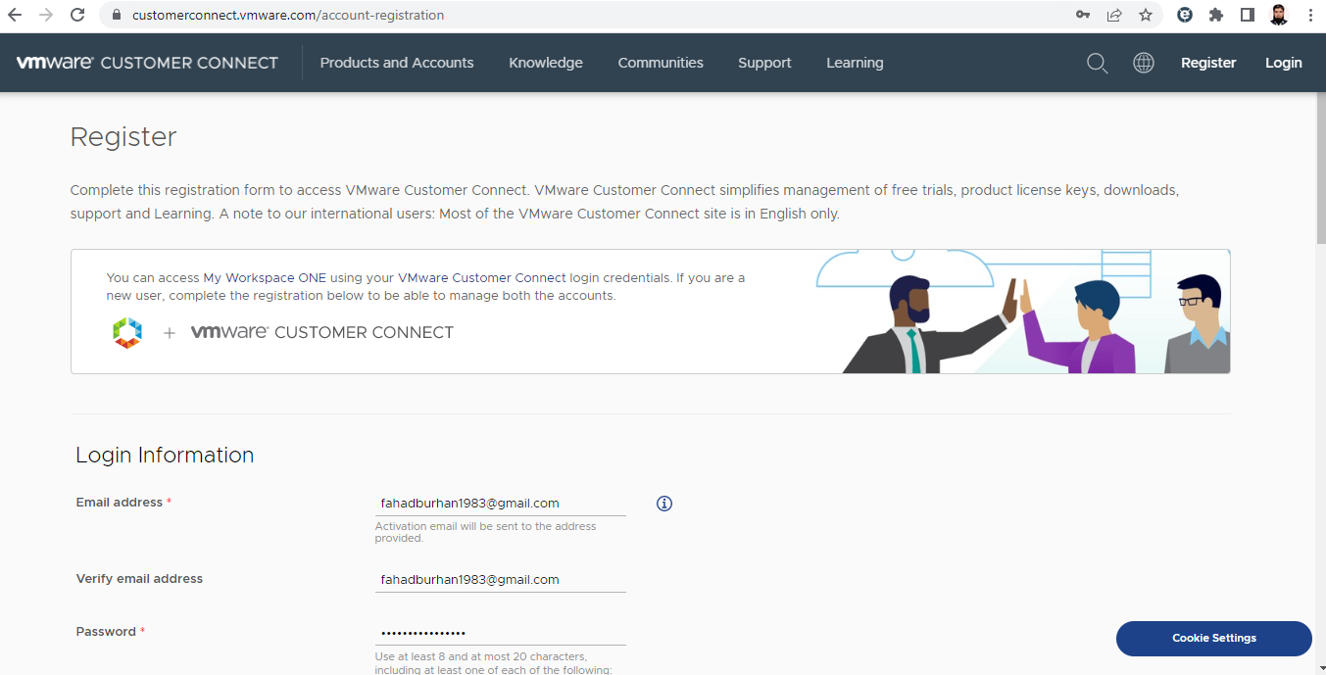
Fill the registration Form

Slide 8
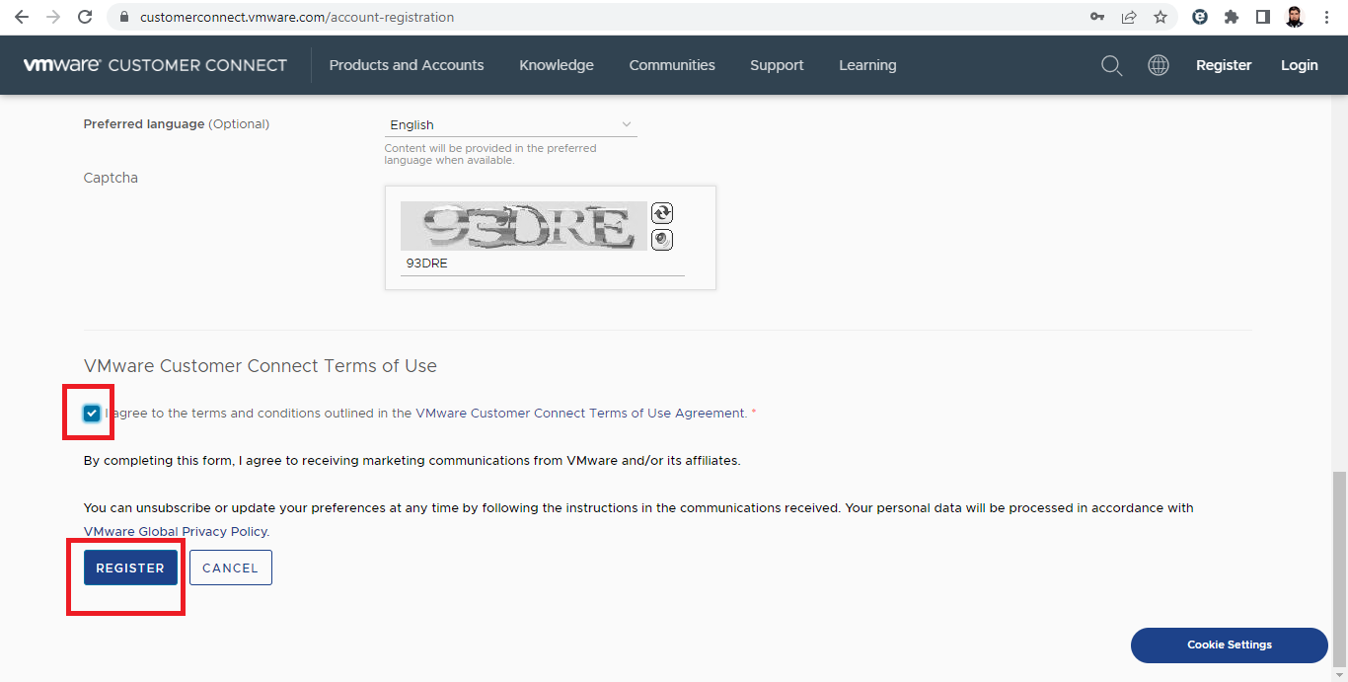
Click on check box and then click on Register

Slide 9
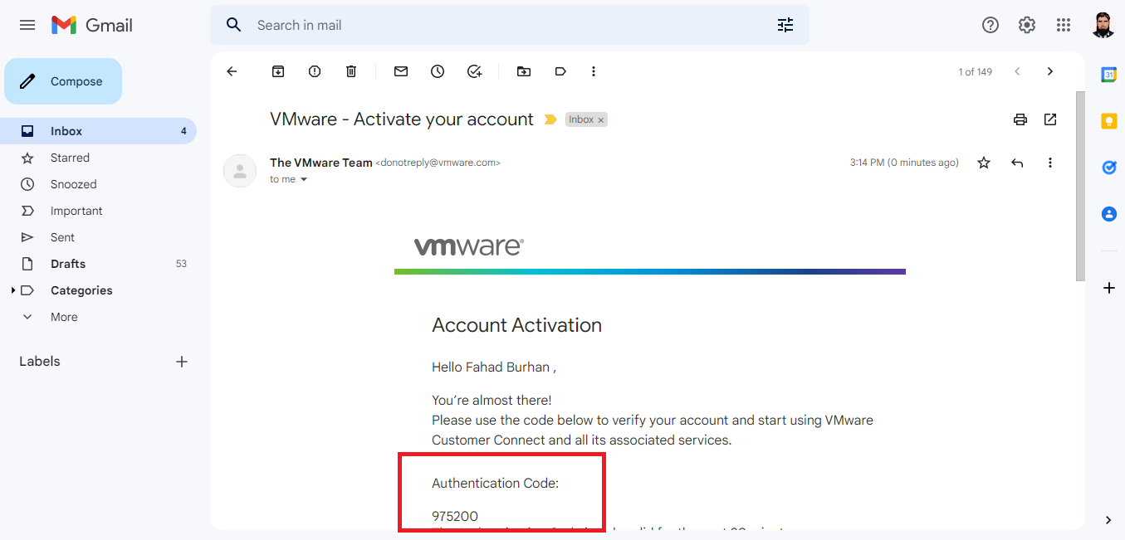
You will receive an email in which you found the authentication code. Remember the code and move to the register page again and type the code

Slide 10
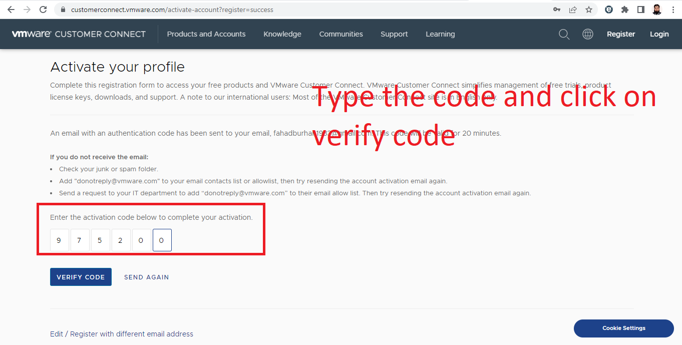
Type the code and click on verify code

Slide 11
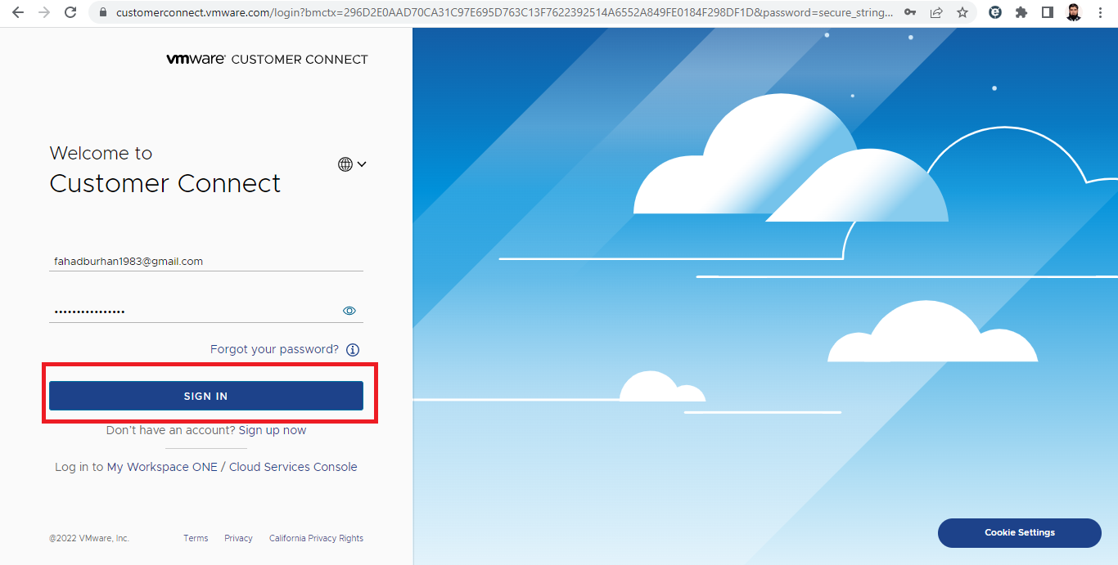
Click on sign in button and the open the link in new tab: https://customerconnect.vmware.com/en/downloads/details?downloadGroup=WKST-1624-WIN&productId=1038

Slide 12
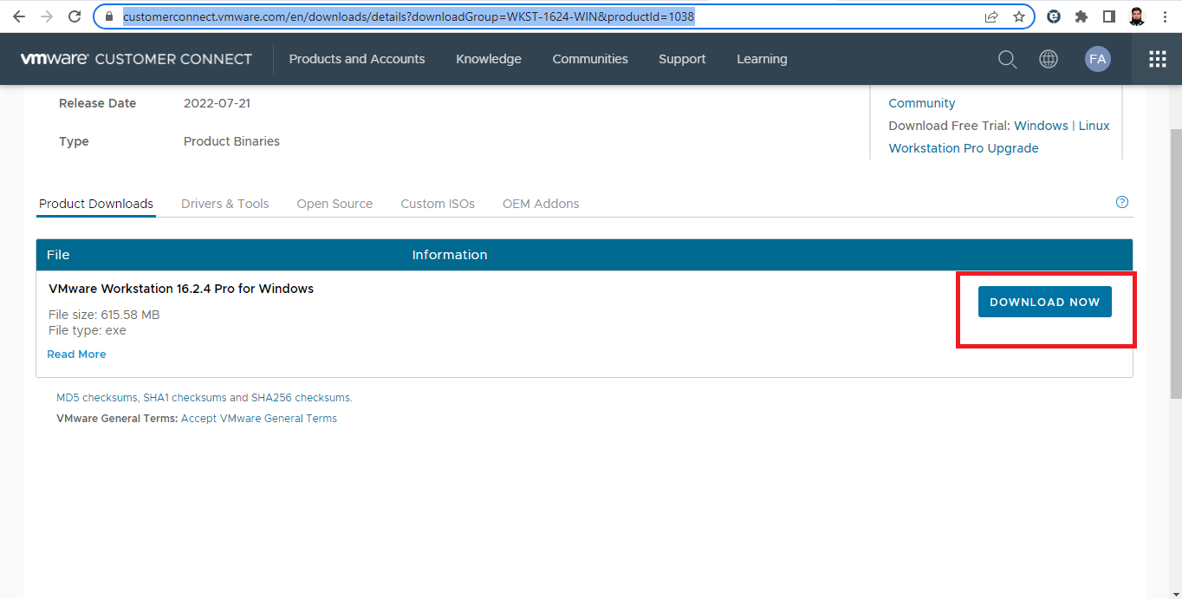
Click on download now

Slide 13
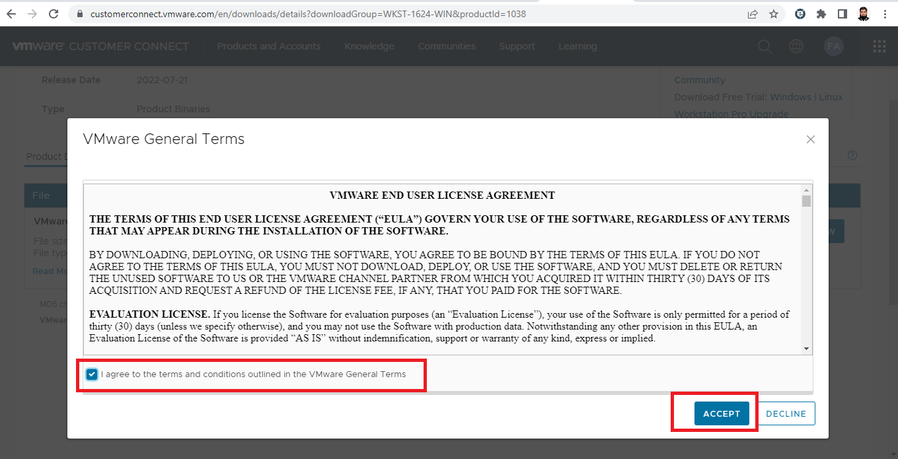
Click on check box and Accept button

Slide 14
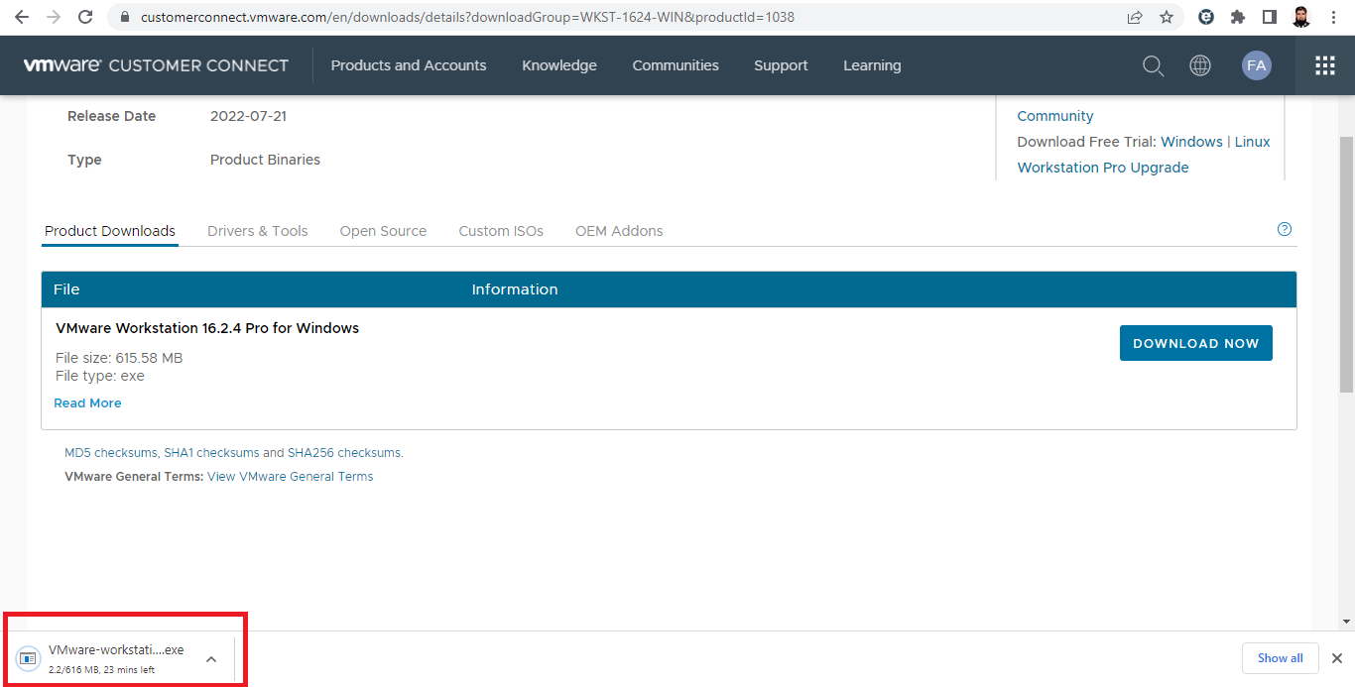
Your downloading will started. Then start your installation

Slide 15
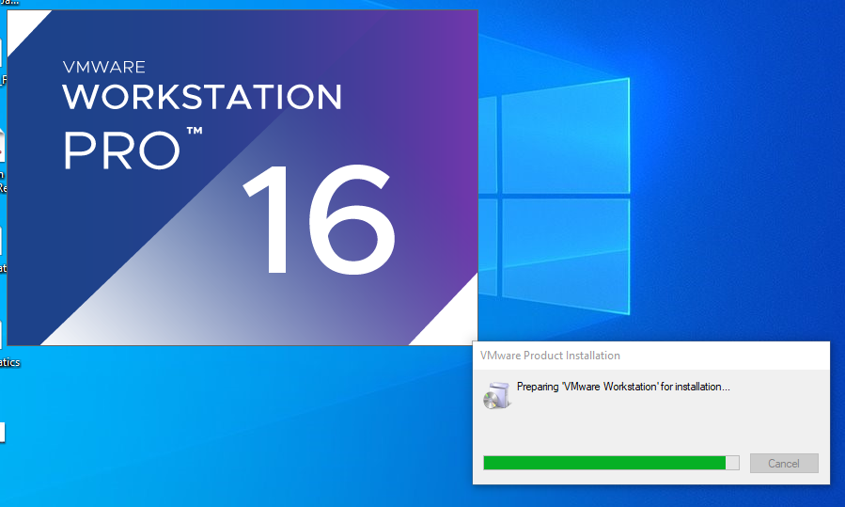
How to install VMware 16 pro on windows 10 double click on VMware pro 16 setup file after few seconds the below screen will appear on your desktop

Slide 16
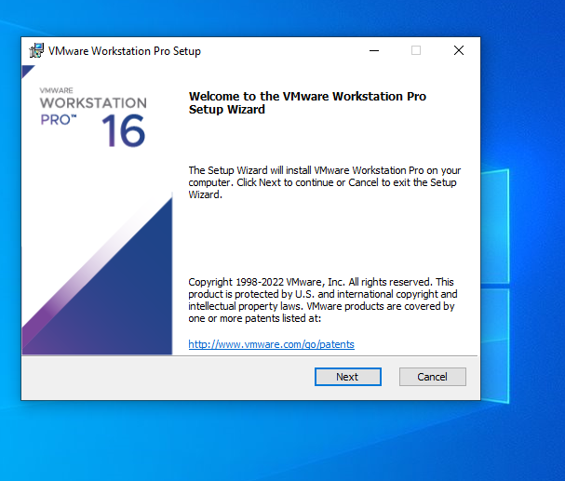
Click on next button

Slide 17
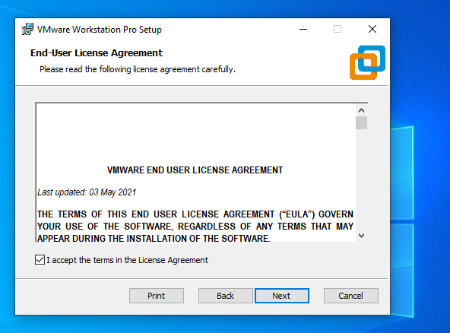
Click on check box and next

Slide 18
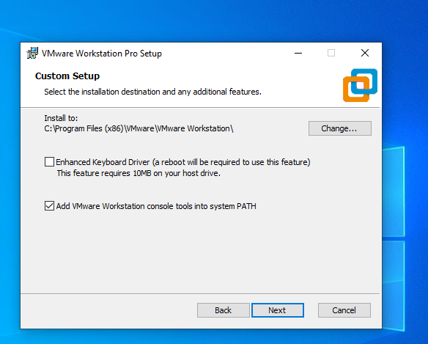
Click on next

Slide 19
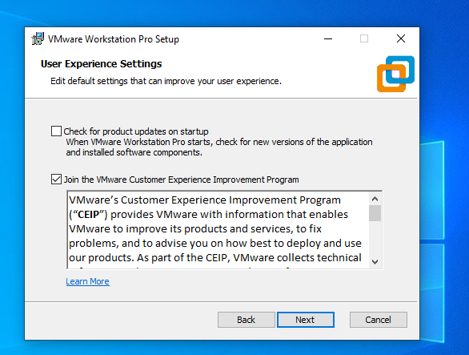
Uncheck the first check box and then next

Slide 20
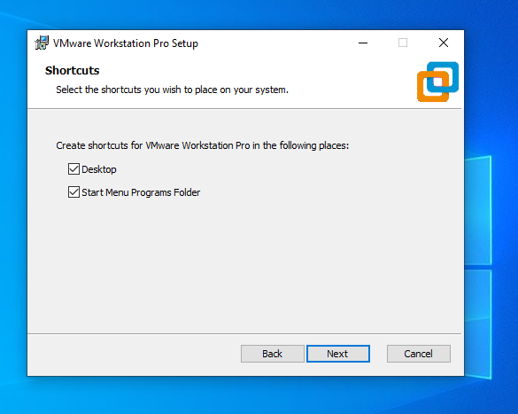
Click on next

Slide 21
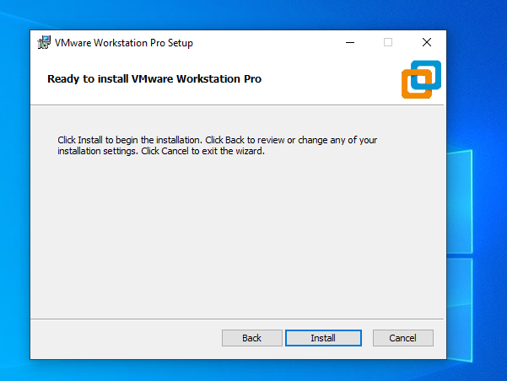
Click on install

Slide 22
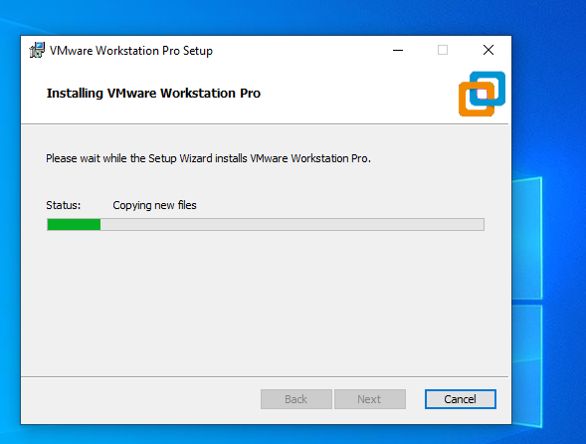
Installation in progress

Slide 23
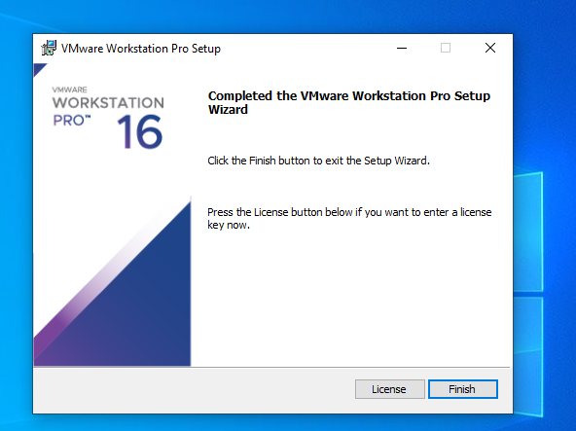
Click on finish button your software is ready to use

Slide 24
Task for Students
All the students are required to download and install VMware for windows and Bare Metal.

Slide 25
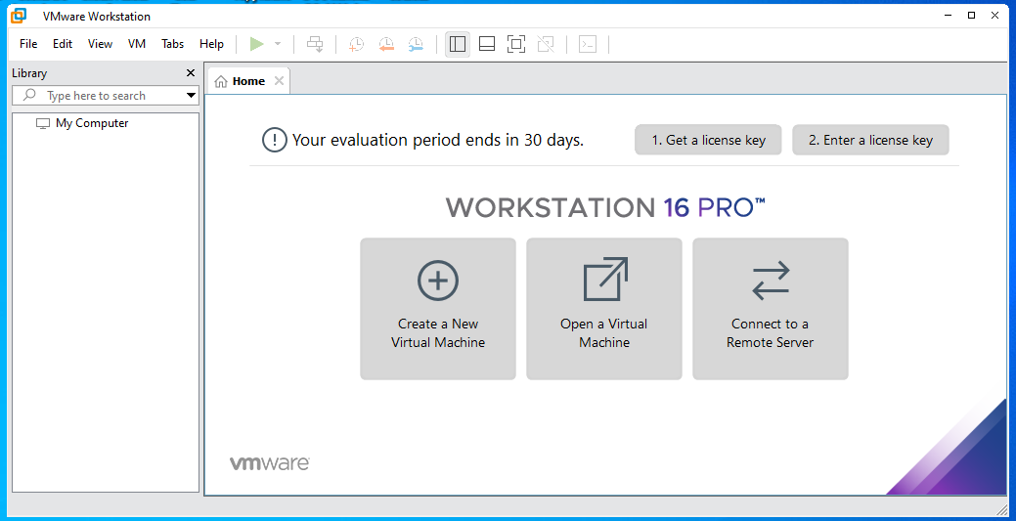
How to create virtual machine for Windows 10
Double click on VMware software that you already install on your machine
You will find the just like below user interface on your desktop.

Slide 26
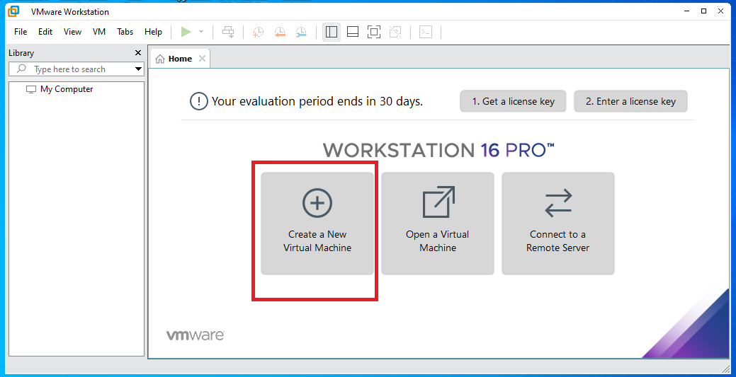
Click on create a new virtual machine

Slide 27
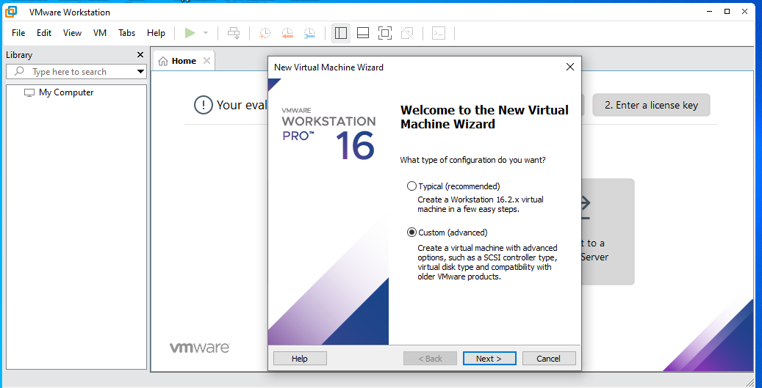
Select the custom (advanced) option and the click on next button

Slide 28
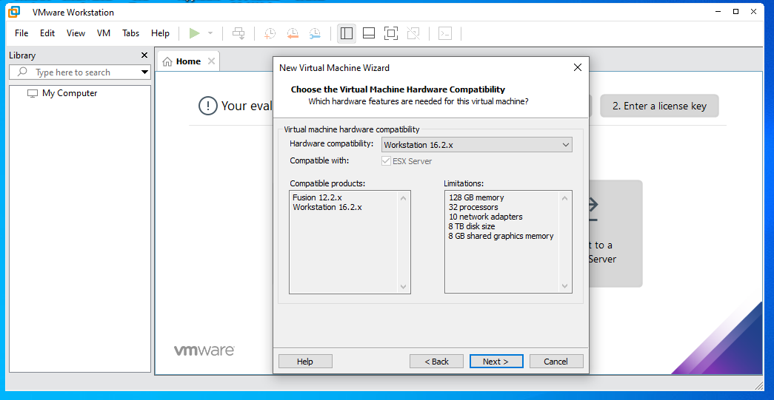
Click on next

Slide 29
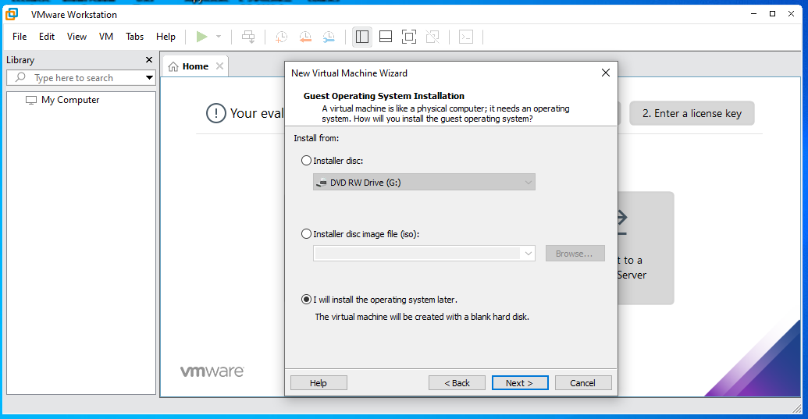
Select the last option I will install the operating system later

Slide 30
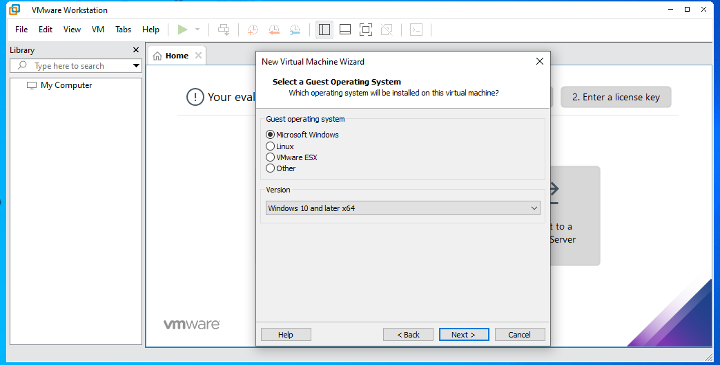
Select the first option Microsoft windows

Slide 31
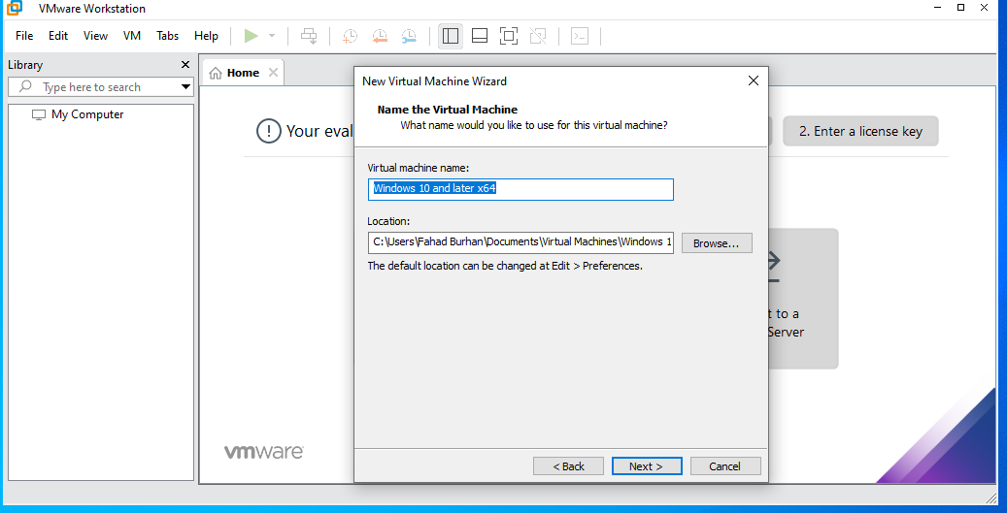
If you want to change the location as per your choice otherwise click on next

Slide 32
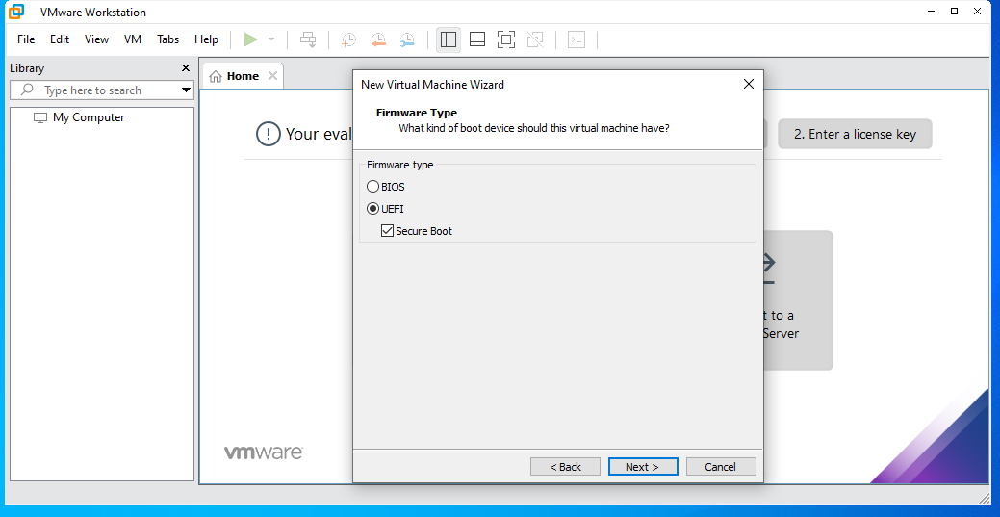
Select the UEFI option and then check the secure boot choose the next

Slide 33
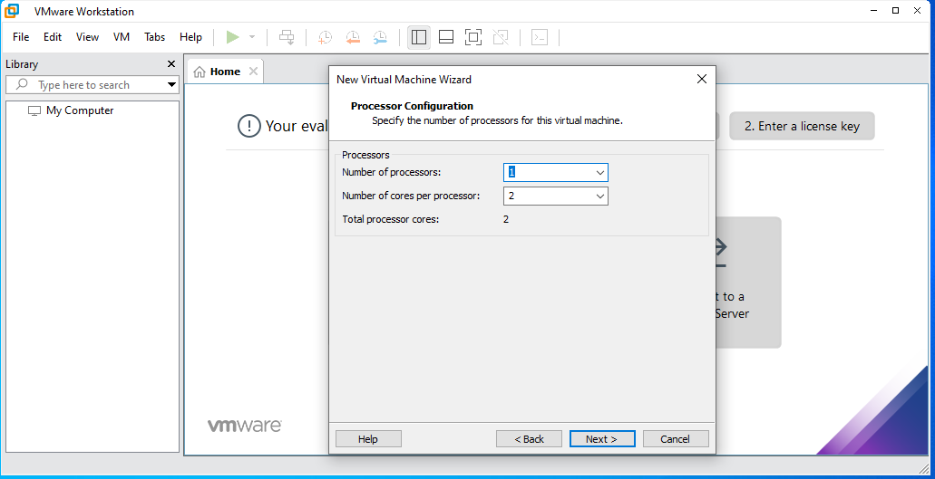
Click on next

Slide 34
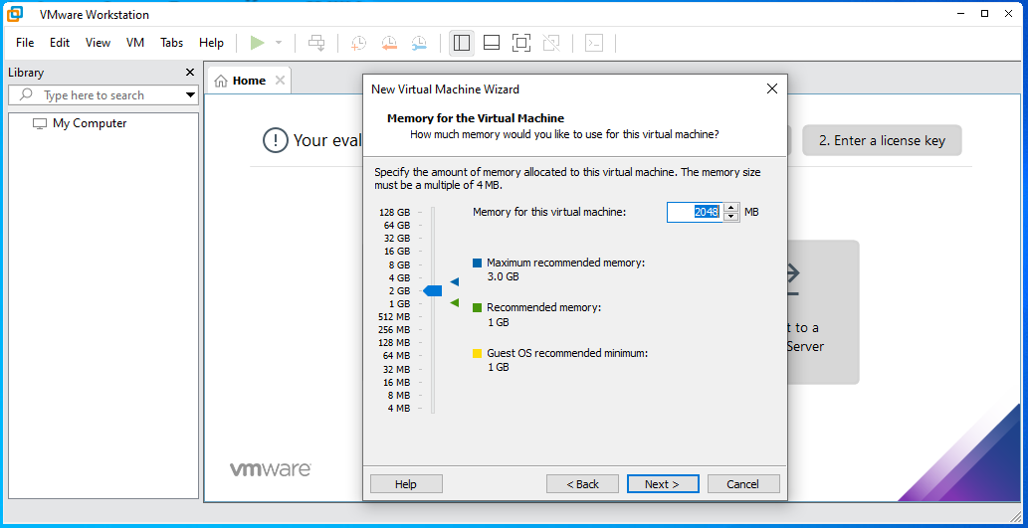
Choose the RAM, but keep in mind that overall how much ram capacity is available. My system ram is 4 gm so therefore I select 2 gm for virtual machine

Slide 35
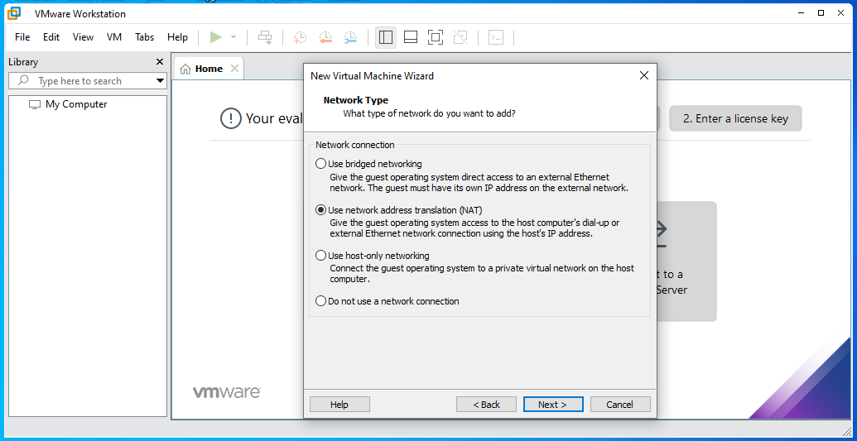
Choose the second option

Slide 36
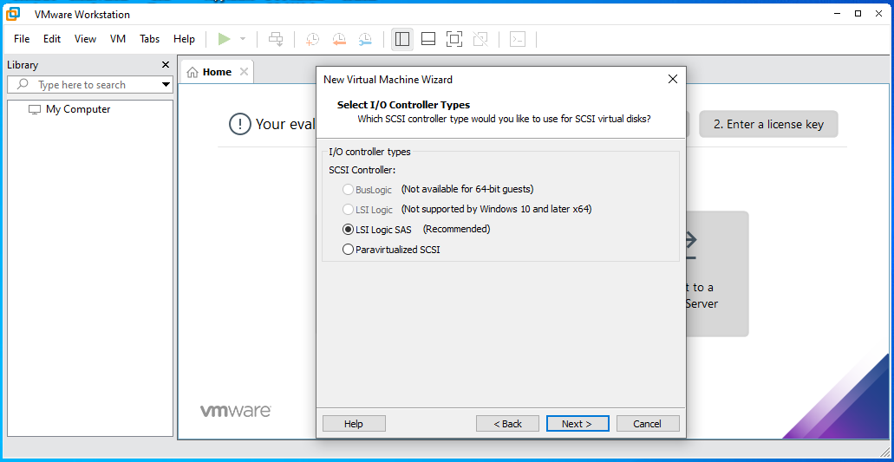
Choose the LSI Option and next

Slide 37
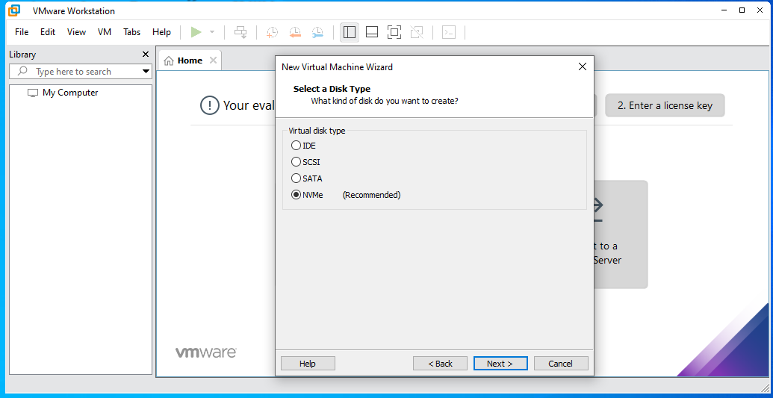
Choose NVMe option

Slide 38

Choose the first option create a new virtual disk

Slide 39
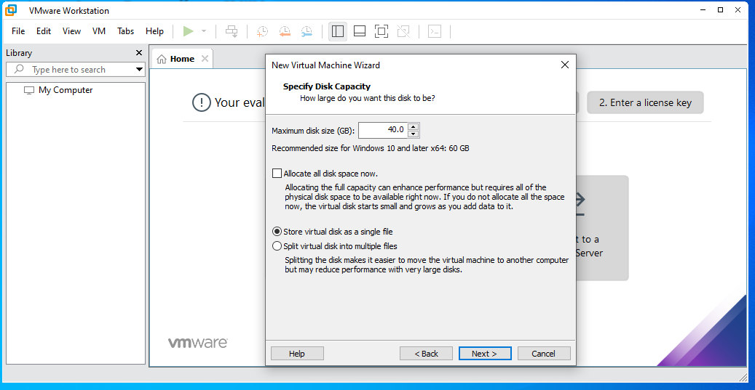
Specify the disk size and select store virtual disk as a single file option and choose next

Slide 40
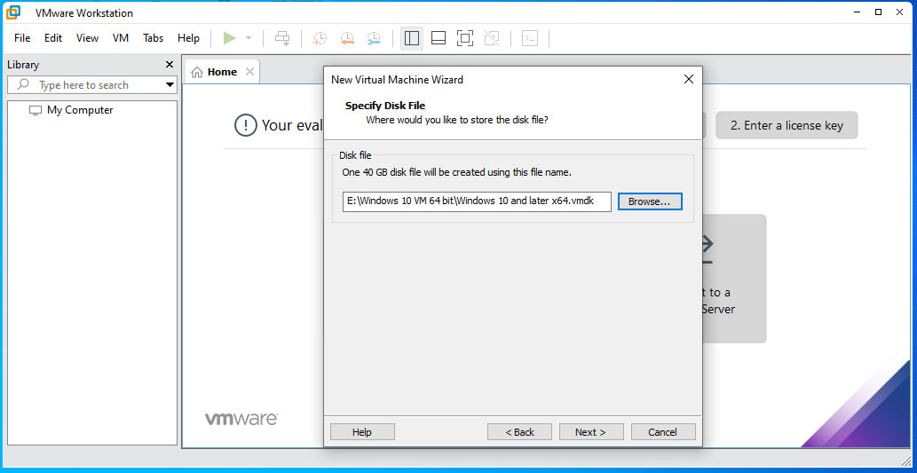
Specify the location Where would you like to store the disk file by using browse button And choose next

Slide 41
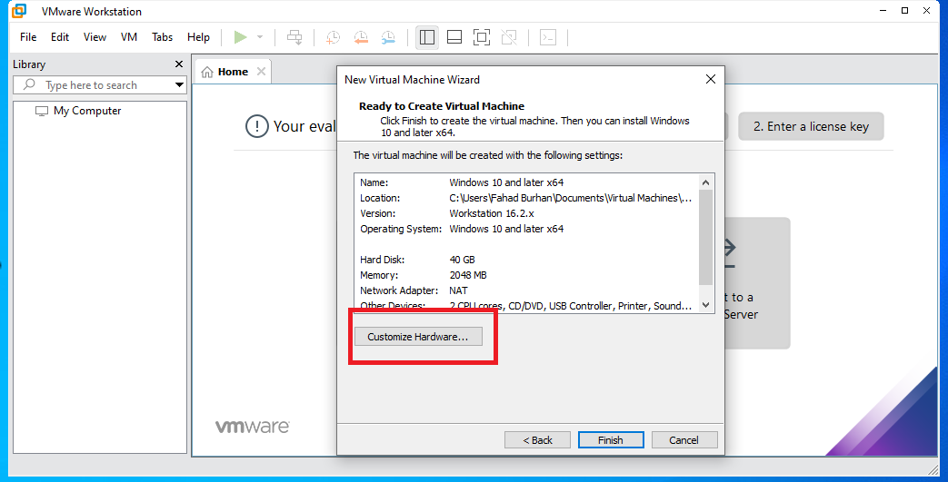
Click on the customize hardware button

Slide 42
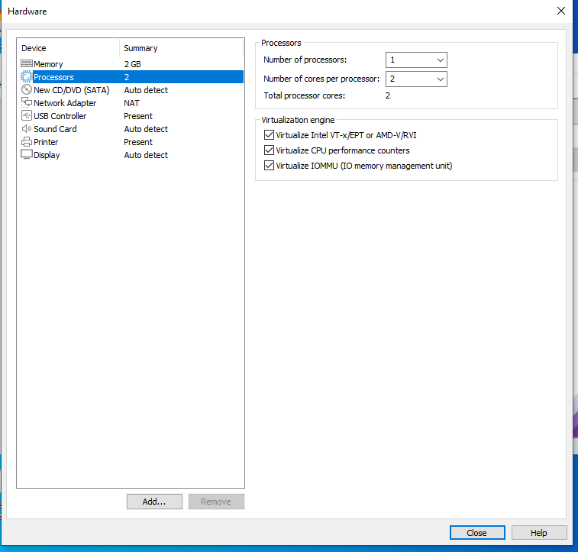
Select the processor and then check all the check boxes under the virtualization engine

Slide 43
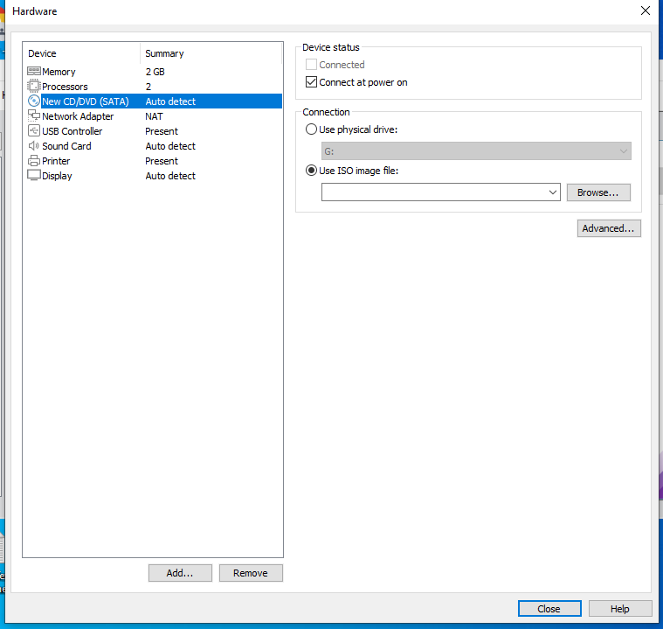
Select the new cd/dvd (sata) and then chose the use iso image file option

Slide 44
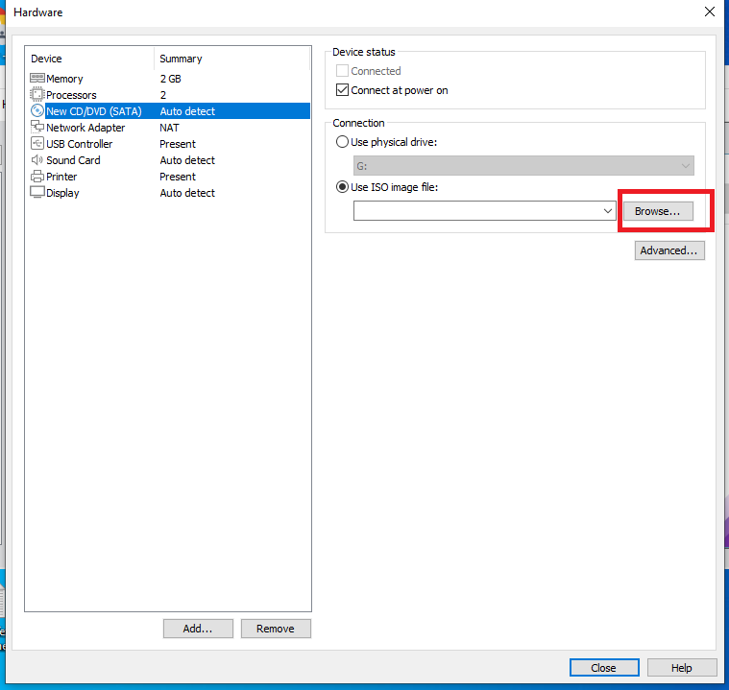
Click on browse button and provide the path for iso file of windows 10, 64 bit and then click on close

Slide 45
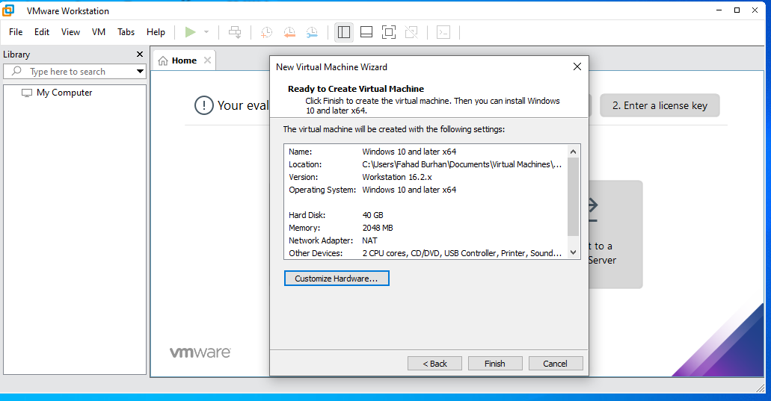
Click on finish button

Slide 46
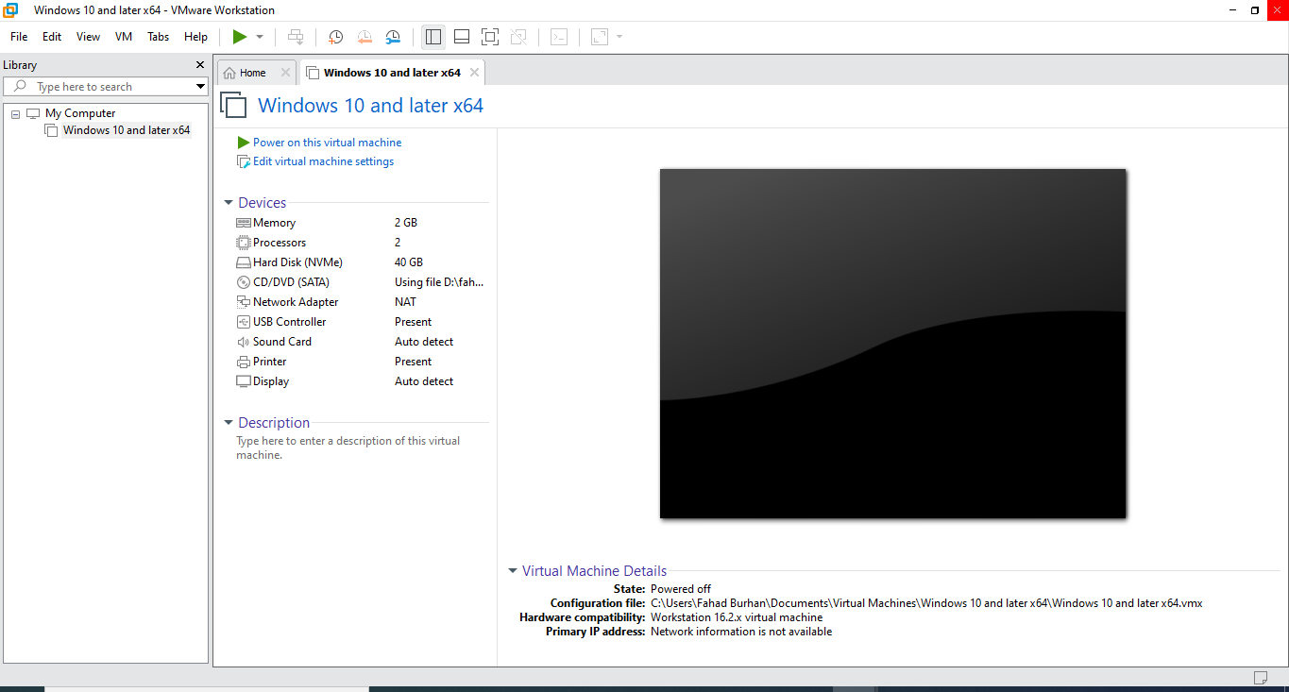
Now your are created virtual machine for windows 10, 64 bit successfully.

Slide 47
Task
You all are required to create virtual machine for Linux and Windows 7

